Slide 1
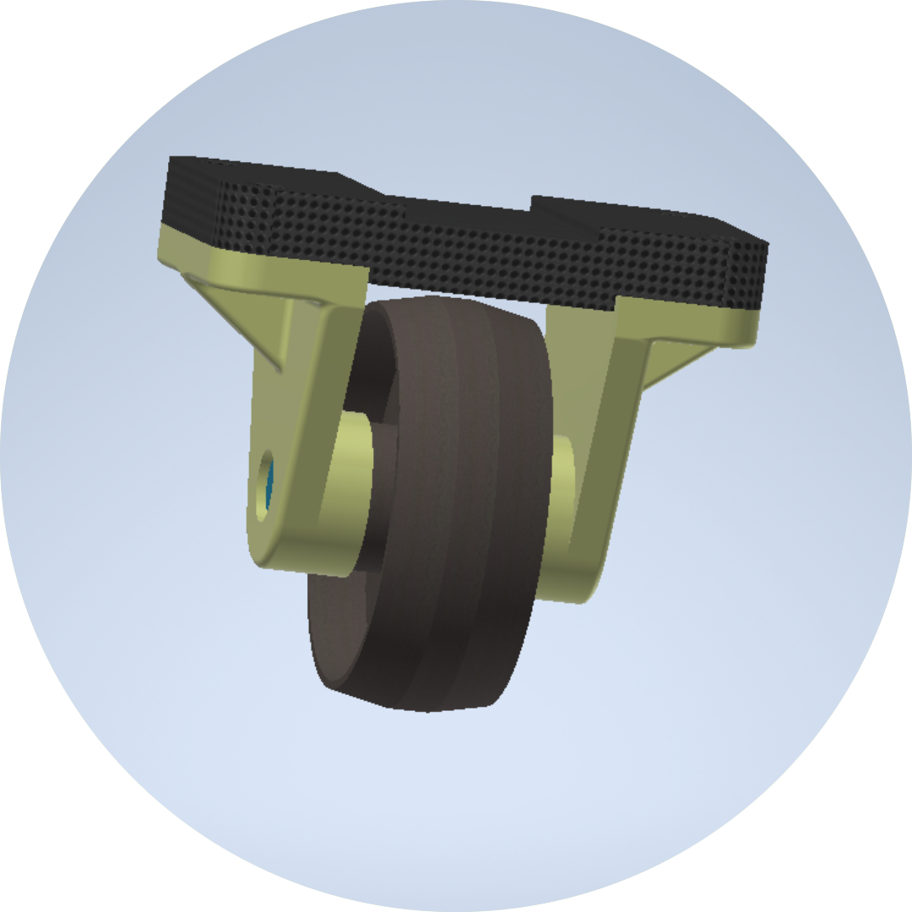
Die set
easing heavy skidding

Slide 2

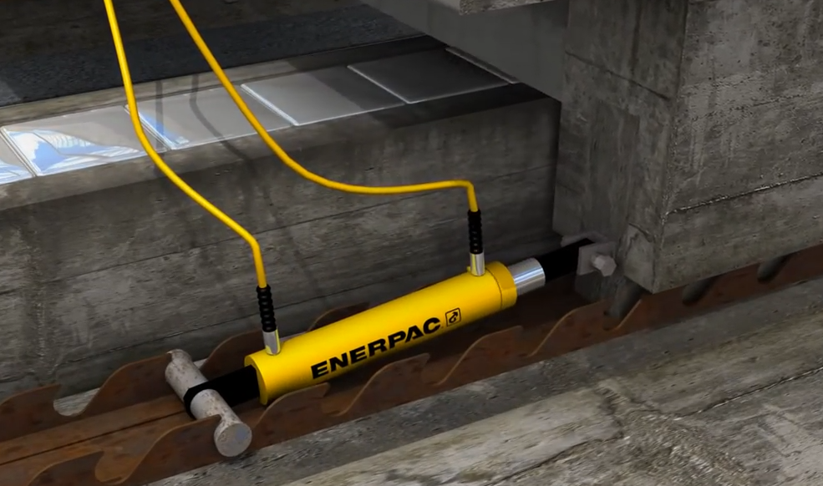
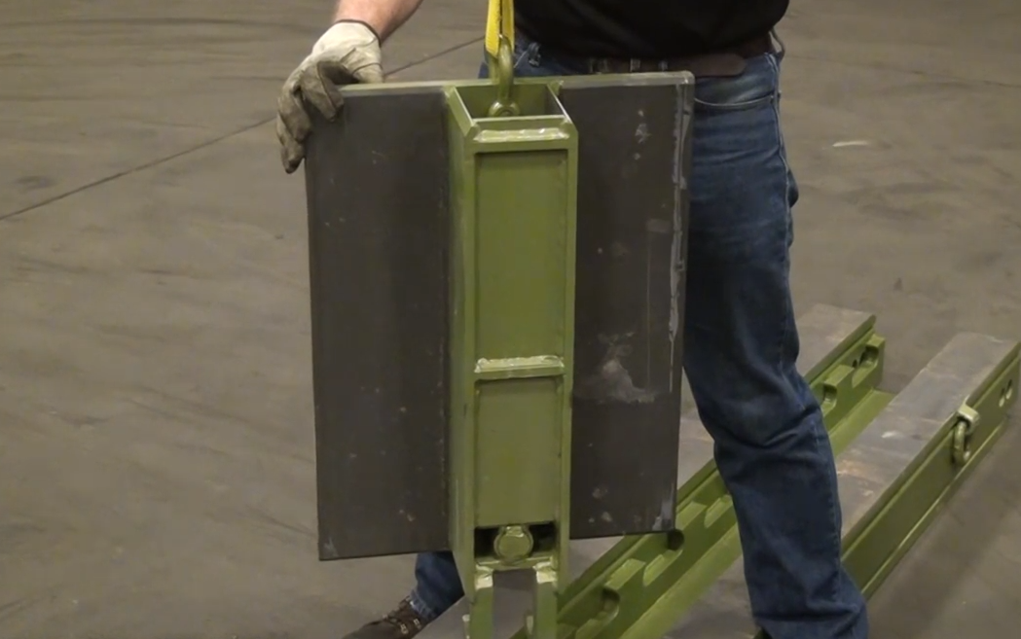
Problem
Heavy tracks. Casts.
Complicated plate tracks.
Enormous hydraulics.
Costly tracks.
(Video Evidence)

Slide 3
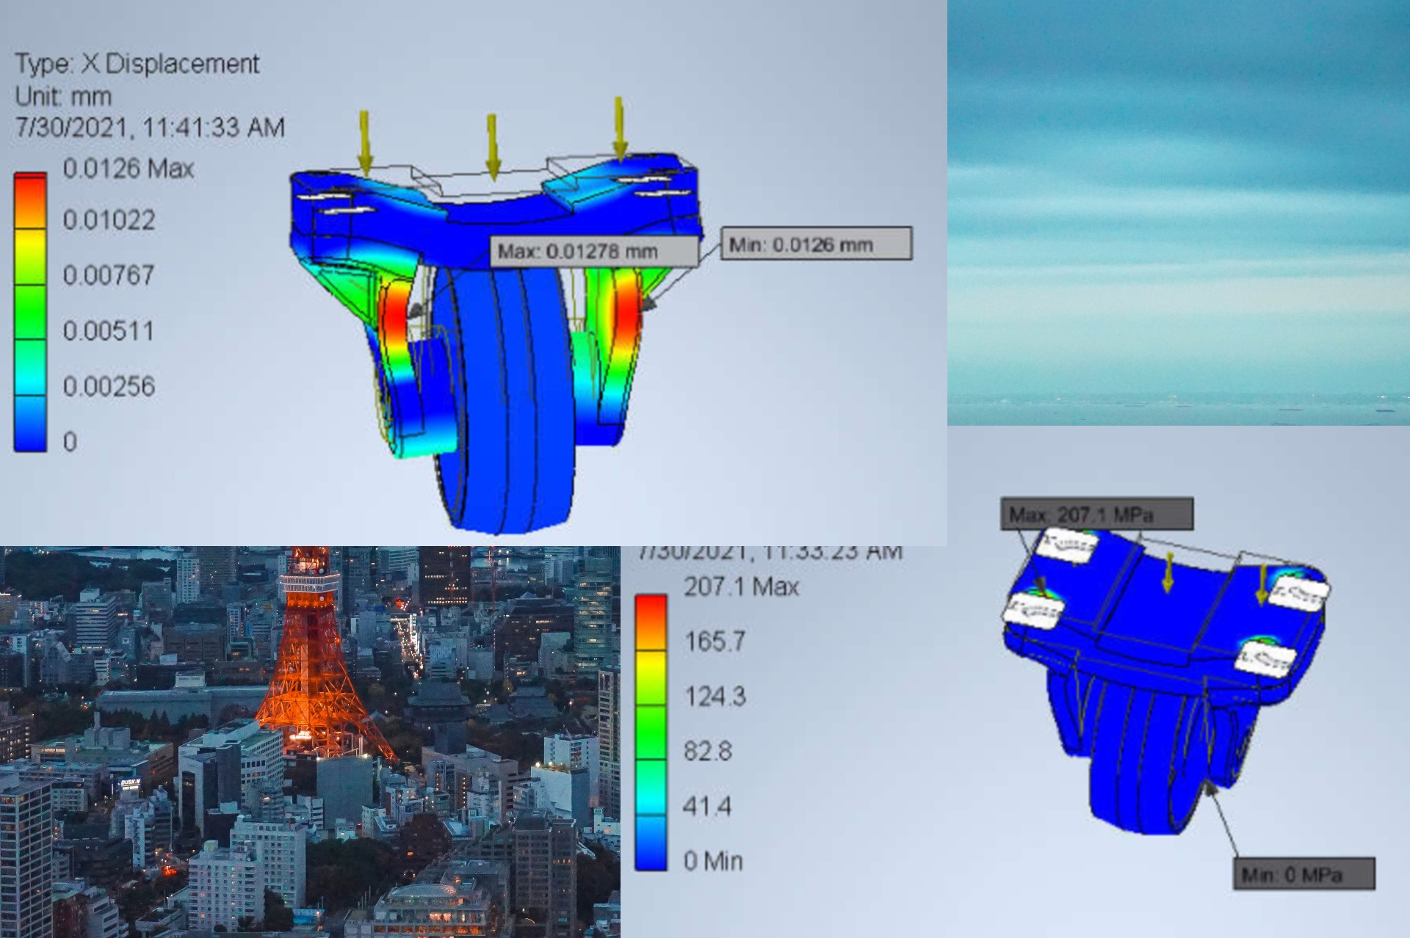


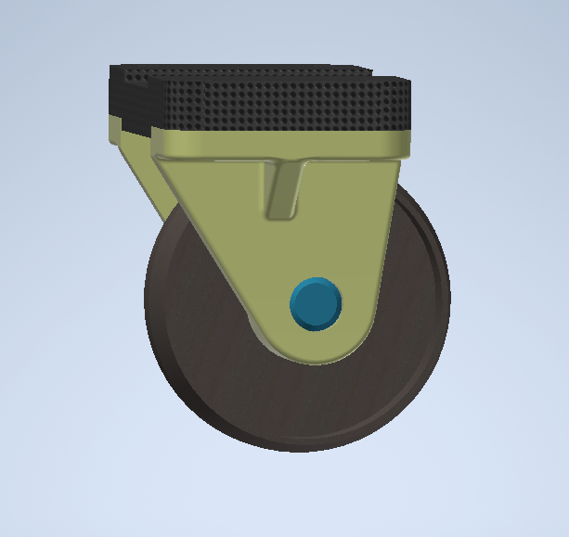
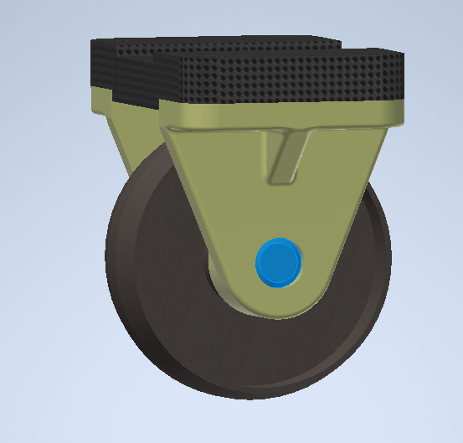
Caster angle effect 01
Caster wheel 01
Die Set 01
caster wheel
Caster angle of approximately 15
0.0126mm X displacement
Die set
Zero Caster angle
0.0097mm X displacement

Slide 4
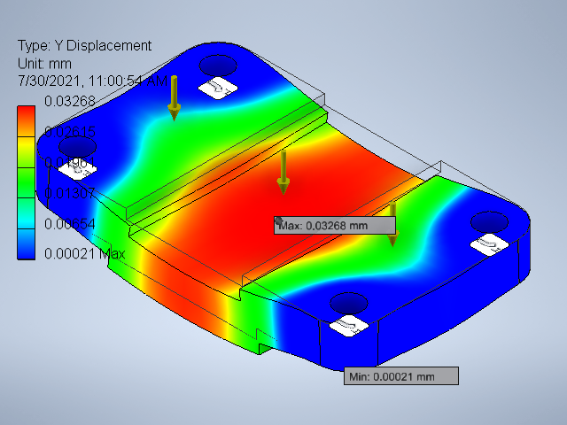


Material
STAINLESS STEEL
MALLEABLE IRON
Top plates loaded with 100,000 N
HIGH CARBON STEEL
 | High Carbon steel | Stainless steel | Mall-eable Iron
Y Displacement | 0.03159 | 0.03268 | 0.05734
Yield Strength | 275 MPa | 215 MPa | 241 MPa

Slide 5
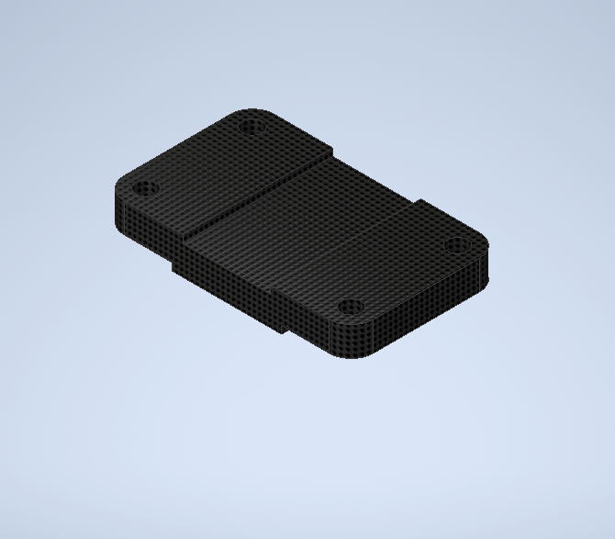
TOP PLATE 01
It is a 136mm by 82 mm by 16mm with four 11mm diameter holes
PART DESIGN: - design with machining in mind.
2D MILLING (16mm flat mill)
- Stock material removal.
- top groove milling (2mm).
- 2 side grooves milling (2mm).
- Filleting (12mm radius).
MILLING: - Milling with mounting in mind.
II. DRILLING (10mm drill)
- Guided drilling(5mm then 10mm)
NOTE: - Two part machining
- machining time

Slide 6
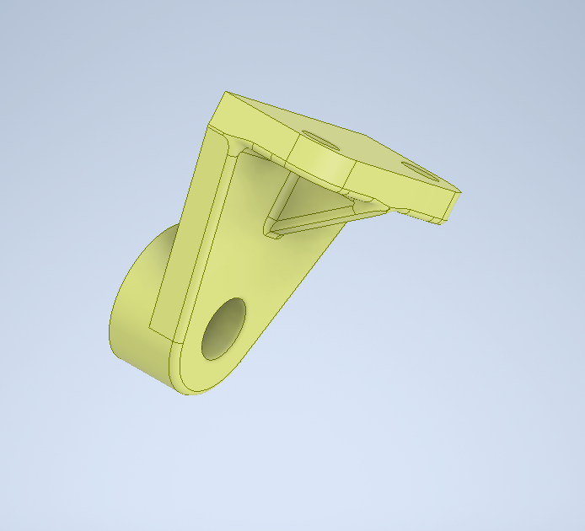
AXLE SUPPORT 02
Connects the wheel axle and the top plate.
Three part machining
2D MILLING
- Stock material removal.
II. 2D ADAPTIVE MILLING
- Milling pockets around the rib.
- Milling the gradient of the rib.
- Filleting edges.
- Drilling by milling.
III. FINISHING
- Ball mill for smooth rib gradient.

Slide 7
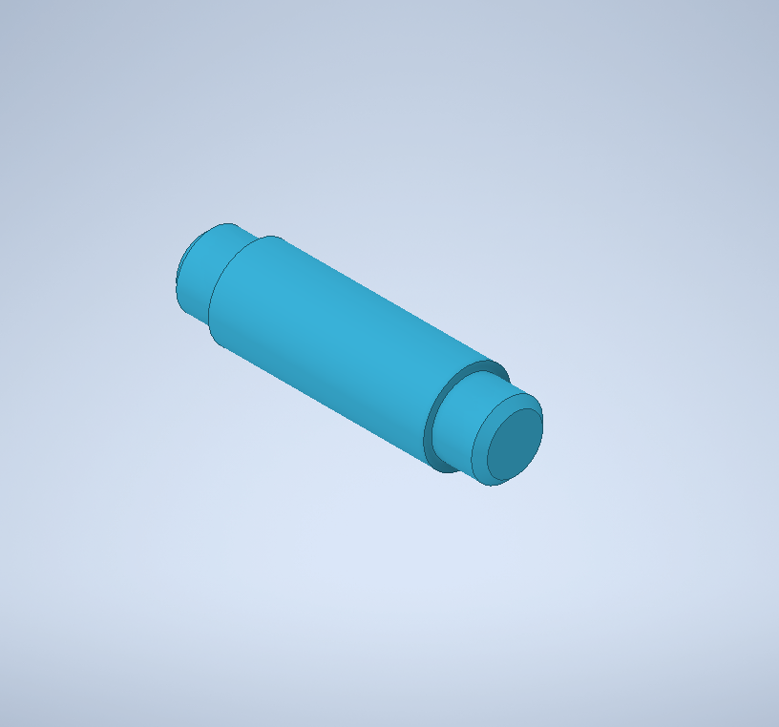
AXLE 03
Supports the wheel. Cylindrical, 21.9mm O.D. , 17.9mm I.D. , and 78mm length.
FACING
- Removal extra stock material.
PROFILE TURNING
- Pattern: chamfer, side parting
NOTE: - two part milling (symmetric)

Slide 8
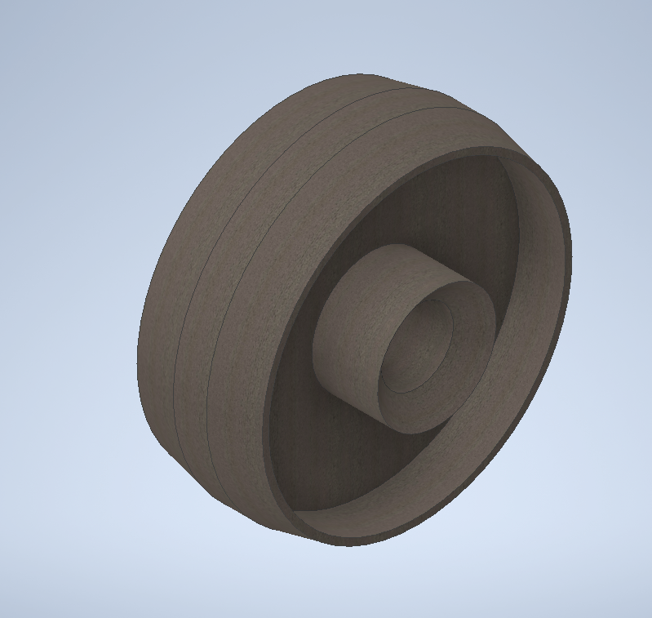
WHEEL 04
Interfaces with either the rail or the ground.
2D MILLING
- Stock extra material removal.
2D CONTOUR MILLING.
- chamfer milling
DRILLING BY MILLING
- circular milling with increasing feed rate.
Note:- Machining time
- Symmetric two part milling.

Slide 9


NOTE 01
Ball milling tool for 2D milling ribs.
0.5mm material left for finishing.
Tool speed.
NOTE 01 MACHINING TIME
Tool travel path. Idling.
Adaptive milling. Optimized tool path.
NOTE 02 SURFACE AESTHETICS

Slide 10
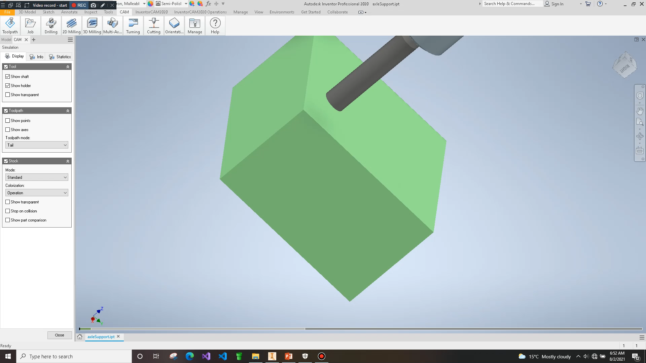
NOTE 02
NOTE 03 not achieved
Synchronizing subsequent adaptive milling operations.
Filleting for the axle support.
Smooth finishing for the axle support’s rib.
NOTE 04

Slide 11
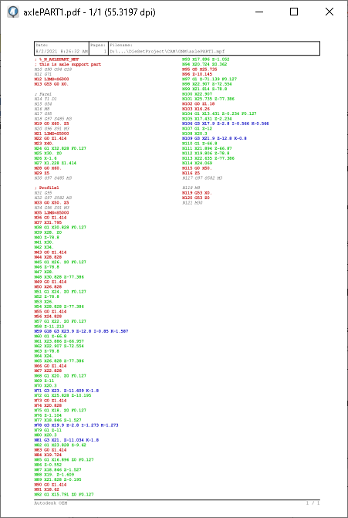
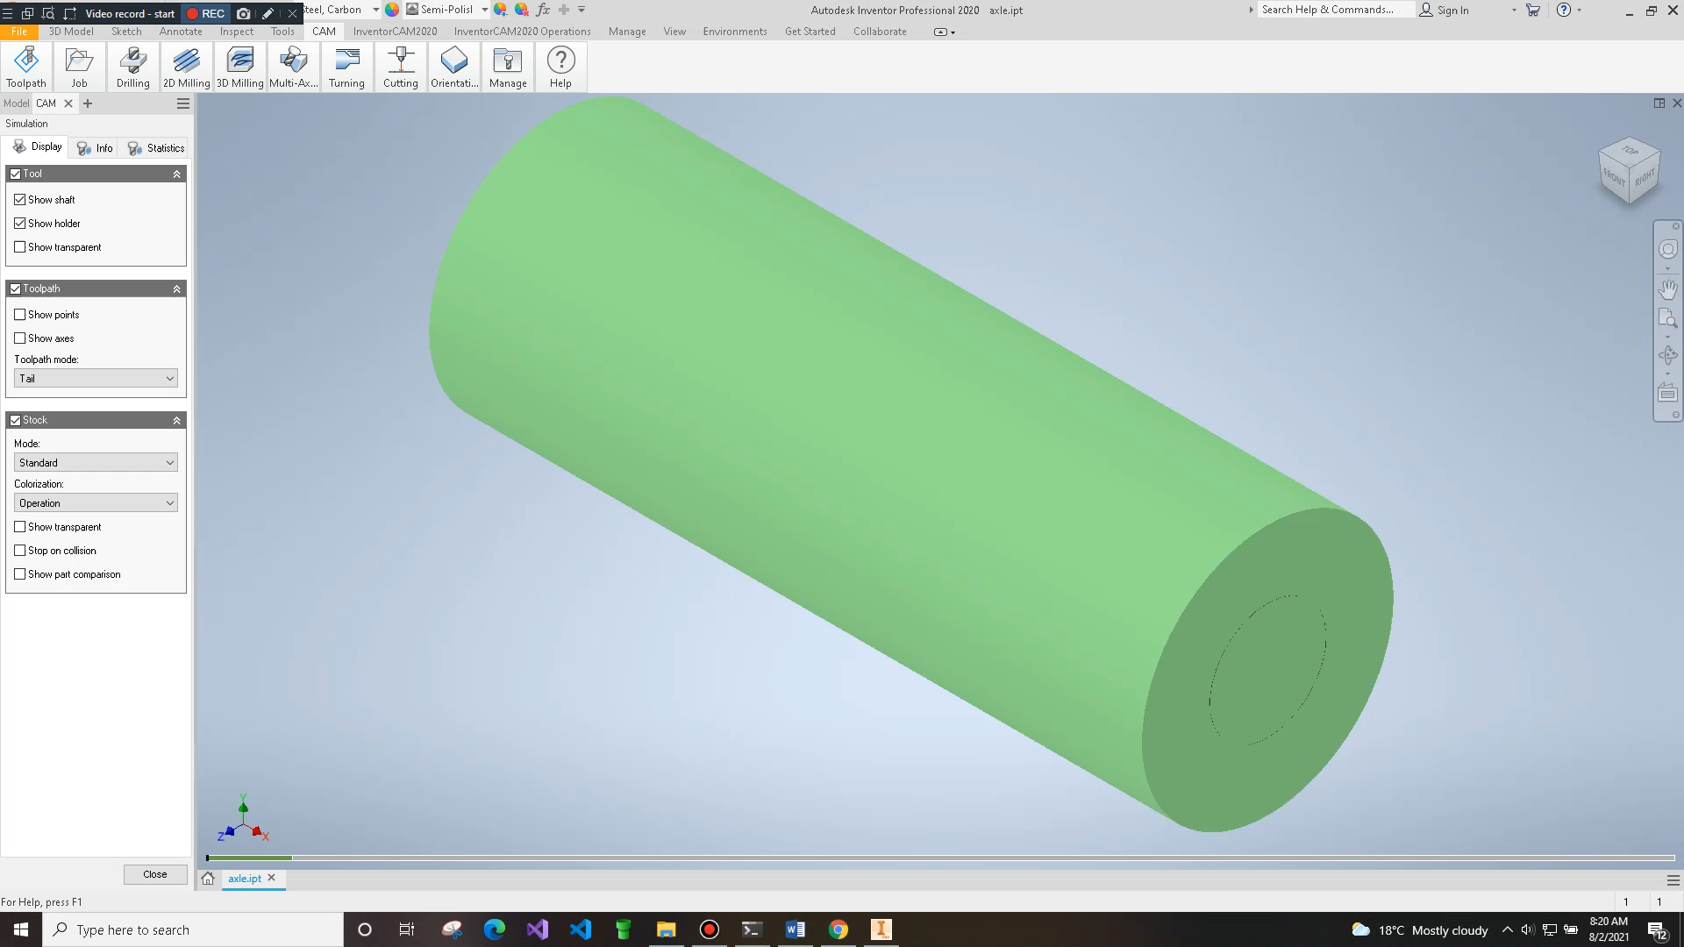
Machining example: axle
Axle
G codes

Slide 12
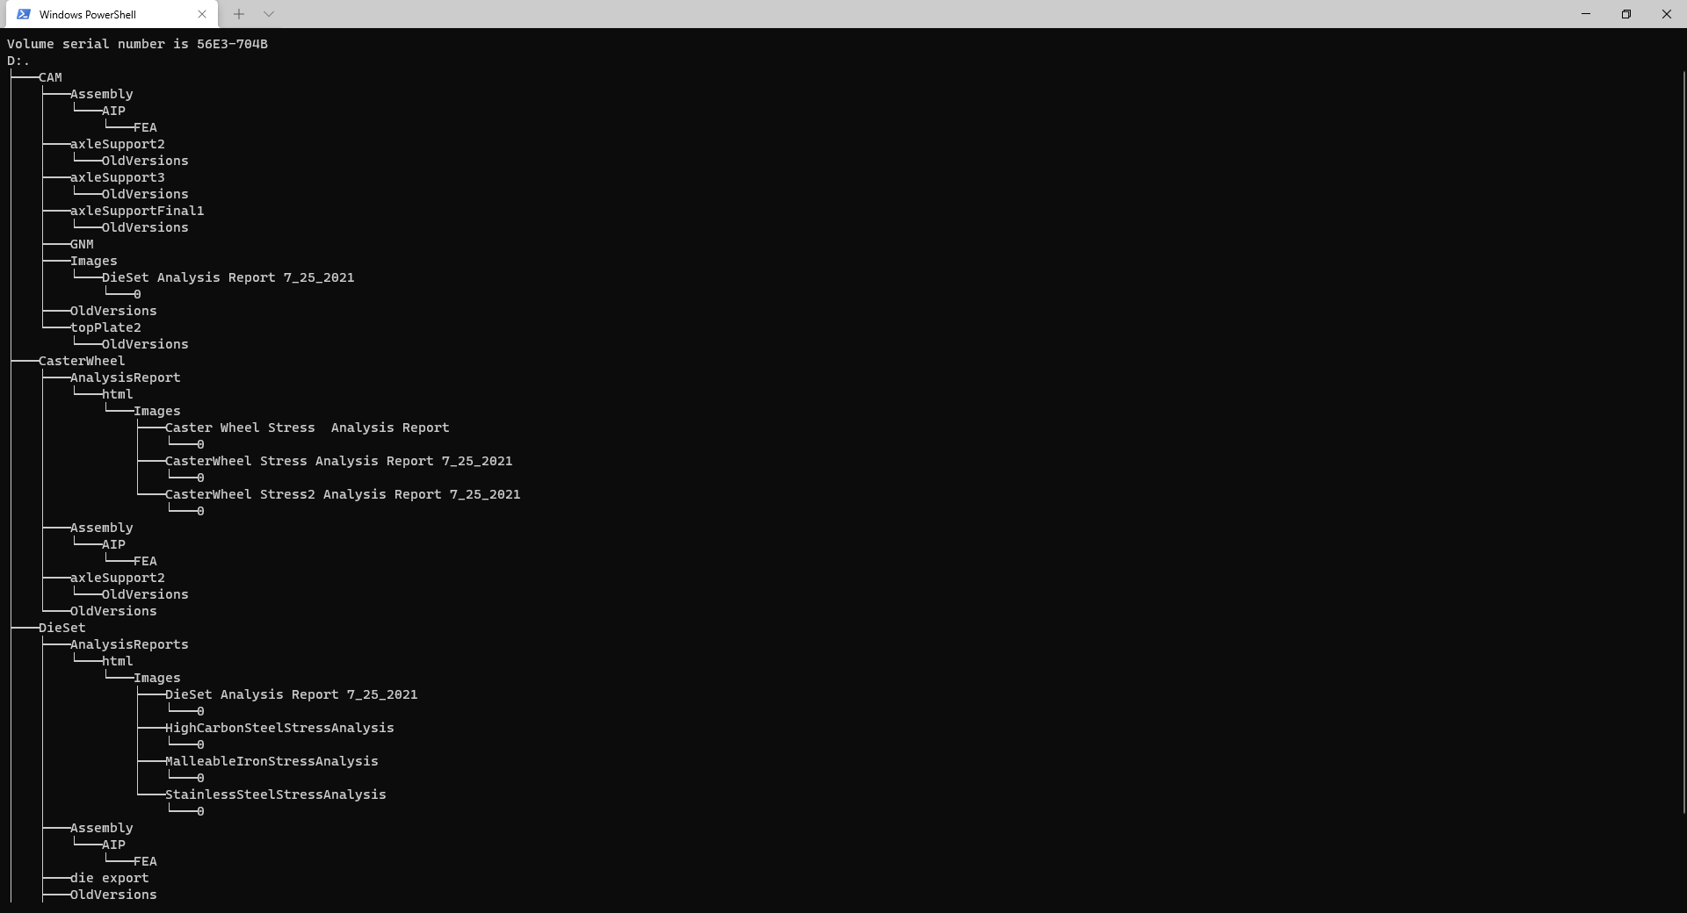
Project files
https://github.com/EricoDeMecha/DieSetProject

Slide 13

Thank you!
KIPNGENO.ERICK@STUDENTS.JKUAT.AC.KE
JUMA.JOEL@STUDENTS.JKUAT.AC.KE
HTTPS://GITHUB.COM/ERICODEMECHA/DiesetProject

